Slide 1

Sound Source Localization based Time Delay Estimation Using Variable Step Size in LMS Adaptive filter
Final Presentation
SP02_Achyuth & Kevin Superviser: Wlodek

Slide 2
1
Introduction
CONTENTS
2
Modeling and Proposed Solution
3
Verification and Conclusion
4
Feedback for Reviewers

Slide 3

Introduction
Sound source Localization Applications
video conferencing
hand-free mobile telephony
and so on
Notes:
Time delay estimation (TDE) is one of the key technologies in sound source localization , and the popular TDE algorithms mainly include ...
Here we are going to talk about the method of LMS adaptive filter

Slide 4
Introduction
Popular TDE methods
TDE is one of the most popular sound source localization methods
LMS Adaptive Filter
Generalized Cross Correlation (GCC)
Eigenvalue Decomposition (EVD)
Acoustic Transfer Functions ratio (ATF-s radio)
Notes:
Time delay estimation (TDE) is one of the key technologies in sound source localization , and the popular TDE algorithms mainly include ...
Here we are going to talk about the method of LMS adaptive filter

Slide 5
Introduction
Problem Statement and Hypothesis
However TDE based on traditional LMS algorithm need to sacrifice the Real-time in sound source localization to improve the positioning accuracy.
Compared with the traditional LMS algorithm, a variable step size (VSS) LMS algorithm applied on a three dimensions sound source localization system is presented
The objective of this paper is to find out whether the new method consisting of the VSS improves the real time performance and positioning accuracy in sound source localization.
Notes:
First problem statement
Second what we present
Third our hypothesis

Slide 6
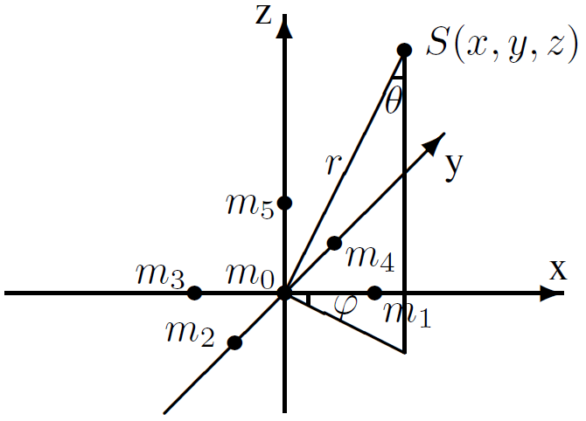
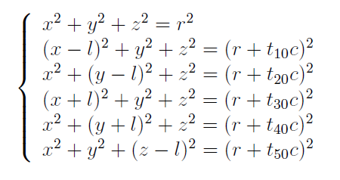
Modeling and Proposed Solution
Modeling of Sound Source Localization
Notes:
We do not care about how to put microphones, So here we choose a 3-dimensions 6-arrays system which is popular and accurate!

Slide 7
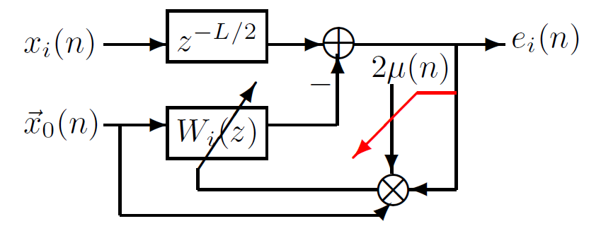
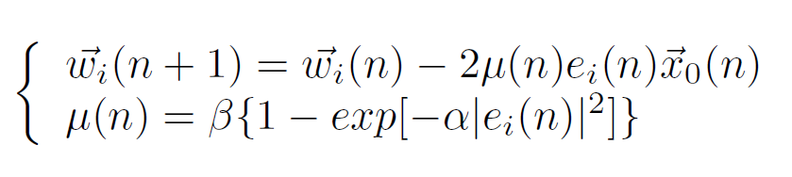
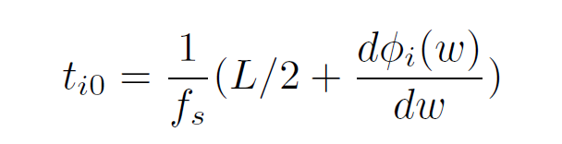
Modeling And Proposed Solution
Modeling of TDE based on VSS-LMS adaptive filter
Notes:
Explain every variables

Slide 8
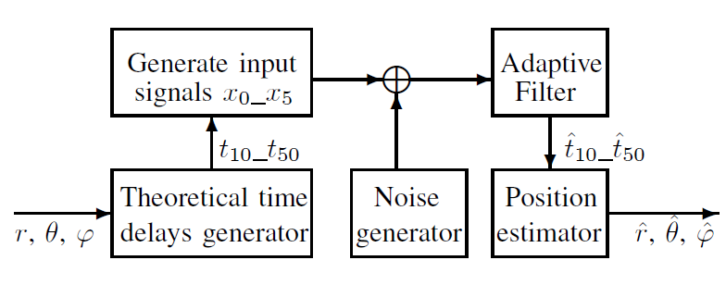
Modeling and Proposed Solution
Implemenation

Slide 9
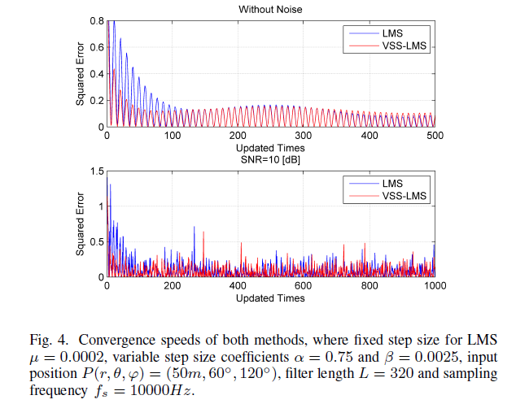
Verification and Conclusion
Verification of real-time performance

Slide 10
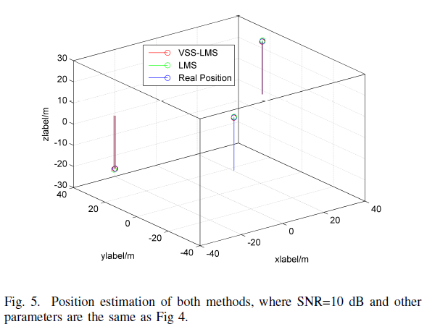
Verification and Conclusion
Verification of positioning accuracy

Slide 11
Verification and Conclusion
Comparing to LMS adaptive filter, TDE based on VSS-LMS adaptive filter has better real-time performance and position accuracy in sound source localization.

Slide 12
Verification and Conclusion
Future Works
Apply on an actual device
Aliasing noise
Mircrophone array model

Slide 13
Feedback For Reviewers
About using more VSS values
About comparing some other TDE methods
About steepest descent algorithm

Slide 14
Thank You
Sound Source Localization based Time Delay Estimation Using Variable Step Size in LMS Adaptive filter
SP02_Achyuth & Kevin Superviser: Wlodek

